Slide 1
Application of Remote sensing and GIS in Mineral Exploration

Slide 2
Remote sensing in Mineral Exploration
Introduction
Remote sensing can play a important role in mineral exploration. Satellite imagery is used to isolate potential ore bearing provinces based on the remote sensing model of knowledge metallogenic provinces.
The use of RS can reduce to the cost of exploration by focusing more detailed ground based studies on areas that show more promise.
Using RS technology, exploration can cover large amounts of land surface and choose areas that require further detailed studies in shortest possible time.

Slide 3
Stages of mineral exploration
There are generally 4 stages to a RS exploration programme
1 Regional overview and reconnaissance- This stage is characterized by prospecting on a scale of 1:500000 to define project area.
2 Preliminary Inventigation- this stage includes surface geological mapping based on the remotely sensed image. site for geophysical & geochemical exploration are identified and a GIS database is created.
3 Detailed surface and sub surface exploration- GIS based image processing techniques are further refined for greater detail
4 Detailed sub surface exploration-This defines mineral exploration at depth by airborne or surface geophysical surveys and drilling

Slide 4
Geological guides for prospecting
There are several geological guides for prospecting that can be observed on RS data.
These include the following :
Stratigraphical- Lithological
Geomorphological
Structural
Rock alteration
Geobotanical

Slide 5
Stratigraphical Guides
Certain types of deposits are confirmed to rocks of certain age groups (coal, iron, manganese)
Rock types analysis and stratigraphic position can be determined from RS data
Attention can then be focussed on sub-areas of greater interest.

Slide 6
Lithological Guides
1 Some minerals deposits are confined to certain type of rock
2 Syngenetic sedimentary deposits(banded iron formations, coal, etc) are regular and extensive
3 Use of MSS spectral characteristics can help identify and locate lithological guides

Slide 7
Geomorphological Gudies
Important for secondary-type deposits produced by weathering and erosion
Suitable sites for deposition can be located with RS(buried channels, etc)
Patter of relief, drainage and slope can be identified.
Areas of placer deposits can be located

Slide 8
Geomorphic features as guides in mineral exploration
Some mineral deposits may have a direct topographic expression
Topography may give clue to understand structures responsible for mineral accumulation
An understanding of the geomorphic history of an area may make possible better appreciation of physical conditions under which minerals accumulated or enriched.

Slide 9
Structural Guides
Mineralisation often occurs in structural belt, shear zones, faults and fractures, joints, etc
Exploration experts look for satellite evidence of structural features along orogenic belt
Remote sensing data is used to focus in promising areas for further exploration

Slide 10
Rock Alteration Guides
Alteration zones are often marked by hydrothermal mineral occurrences
RS images can give a distinct spectral character for different minerals. Each group of minerals has a different spectral characteristics. Two examples of common mineral groups follows.

Slide 11
Alteration Zones Minerals
Kaolinite, montmorillonite, sericite, muscovite, biotite, chlorite, epidote, pyrophyllite, zeolites, quartz, albight, goethite, hematite, jarosite, metal hydroxides, calcite, and other carbornates, actinolite-tremolite, serpentine and talc

Slide 12
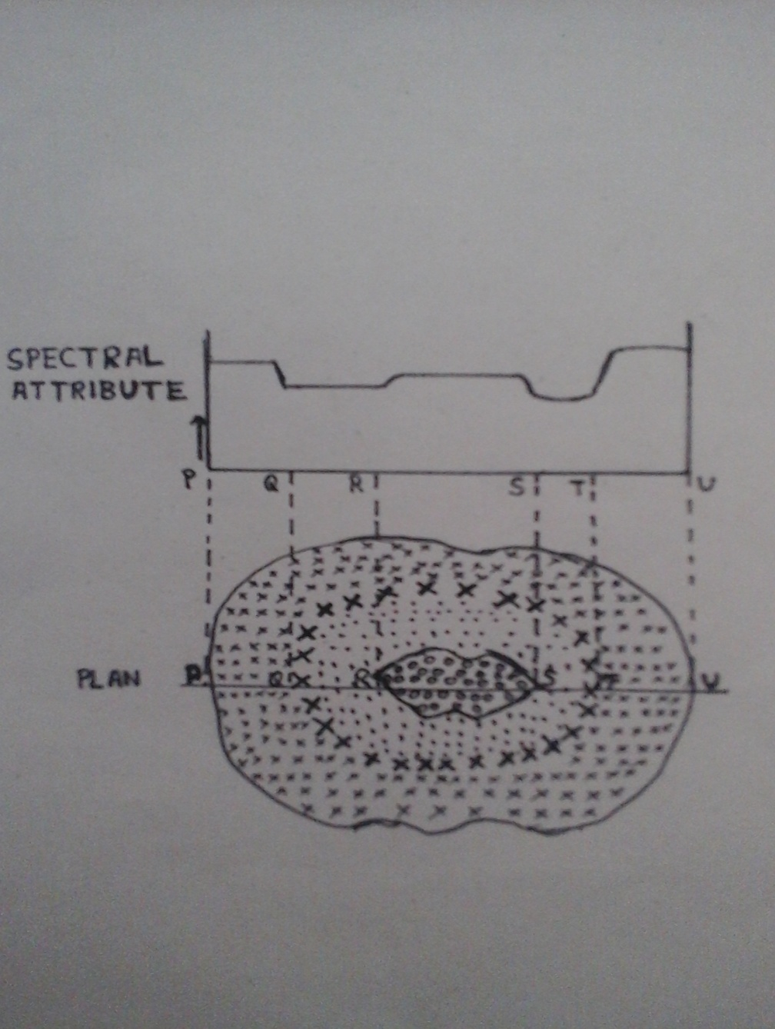
Fig.1.1. Ringed and zoned targets formed by alteration haloes- an idealized systematic illustration showing spectral detective of zoned targets

Slide 13
Spectral Characteristictics
Hydroxyl bearing minerals such as clays and sheet silicates, which contain AI-OHH and Mg-OH bearing minerals and hydroxides show prominent absorption in the 2.1-2.4um range and reflectance at about 1.6um.
This can be highlighted by TM5/TM7 ratio which will yield very high values for altered zones than unaltered.

Slide 14
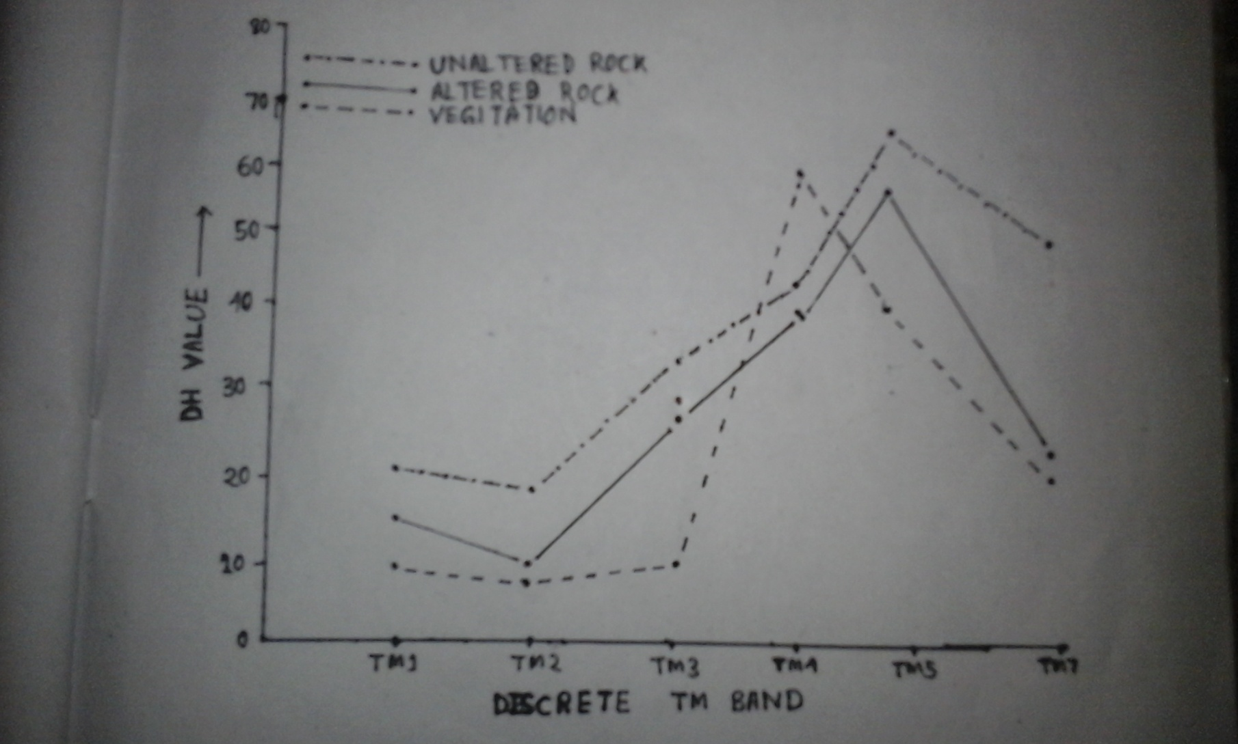
Fig.2. Data plot of Landsat TM DN value for altered rocks, unaltered rocks and vegetation( khetri copper belt )

Slide 15
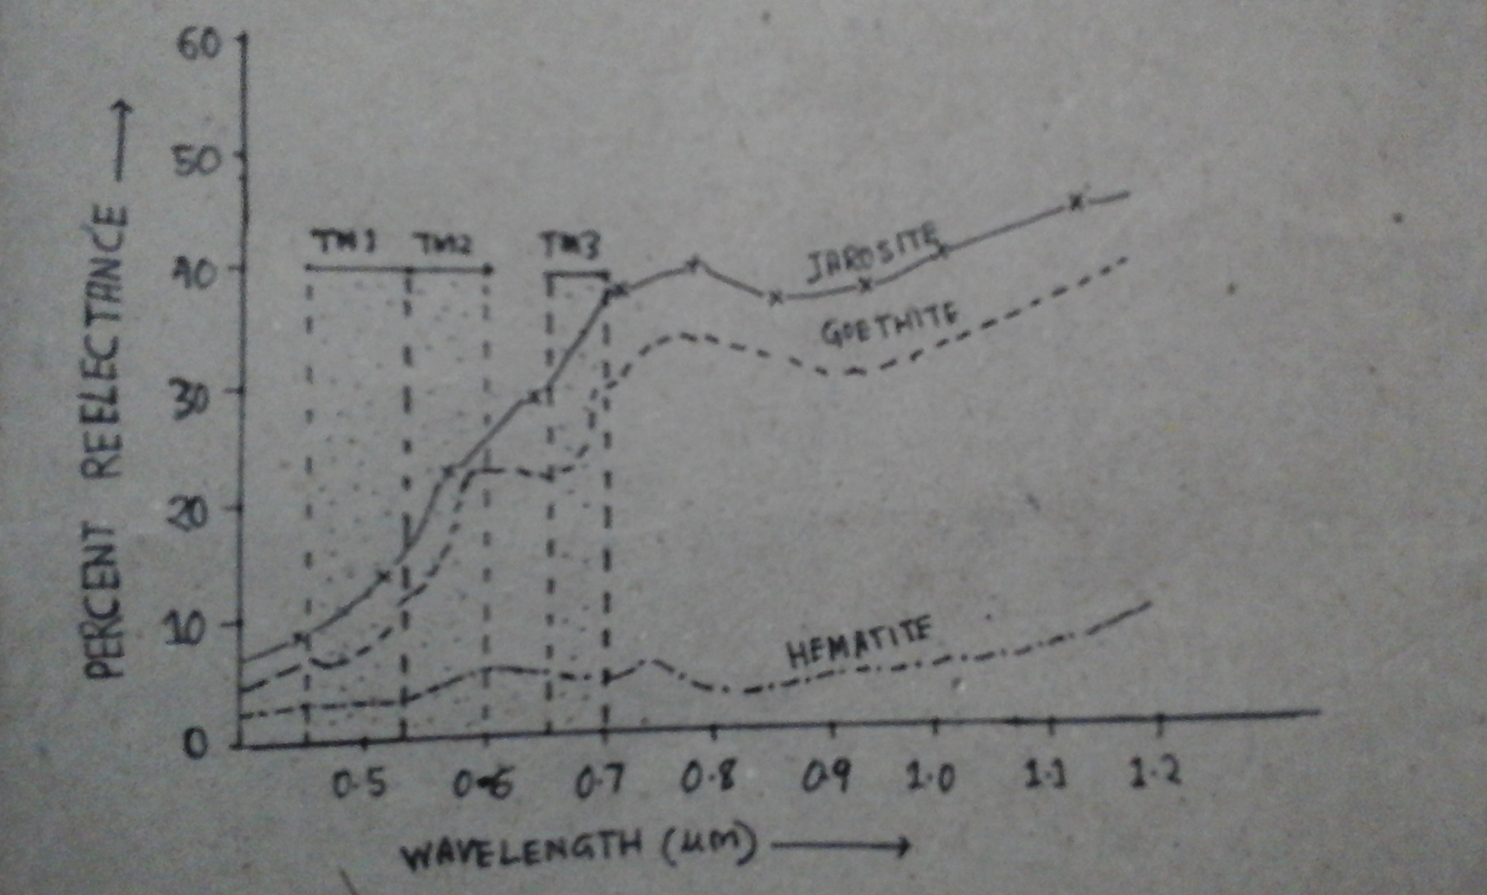
Fig.3. Spectral reflectance curves of jarosite, goethite, hematite. Note the much lower reflectance of hematite than of jarosite and goethite in TM3

Slide 16
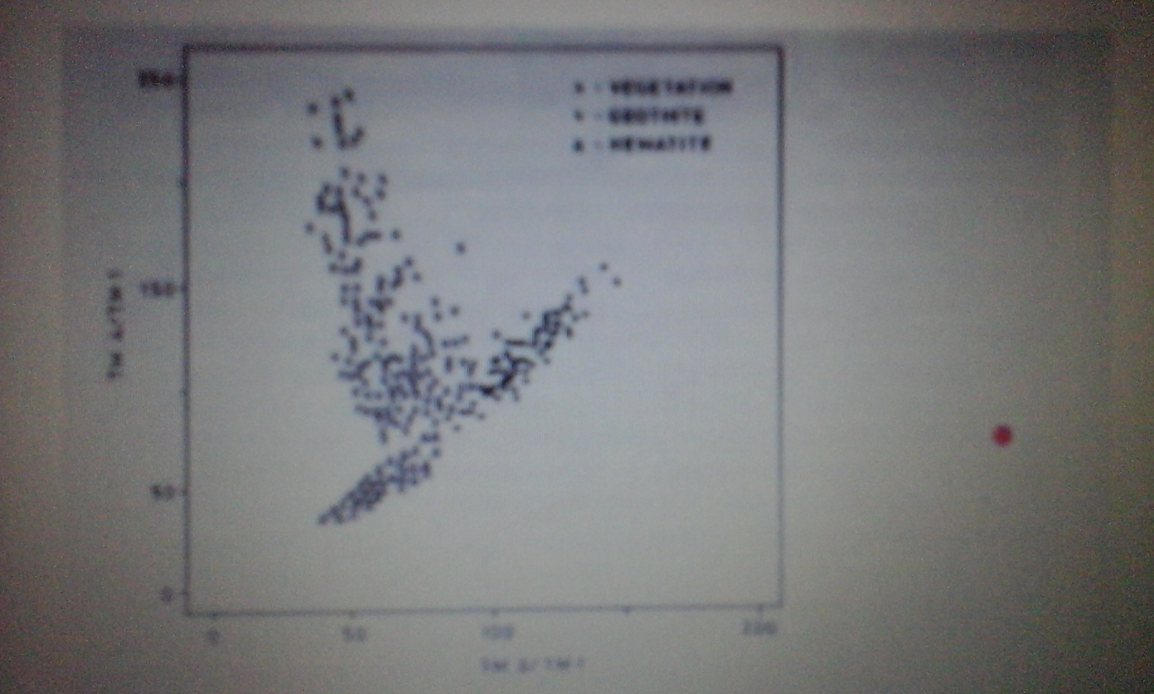
Fig.4. Scater plot of TM3/TM1 vs TM4/TM1 withh field of goethite, hematite and vegitation ( data from Newman area , Western Austrelia)

Slide 17
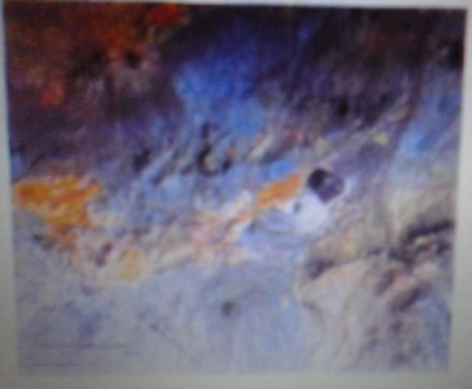
Fig.5.The CRC of apart of the Silver Bell porphyry copper deposit. The arcuate yellowish-orange band that trends from left to right through the center of the area is the alteration zone comprising dominantly iron oxide and clays; field information is in agreement with these data.( Abrams & Brown,1985)

Slide 18
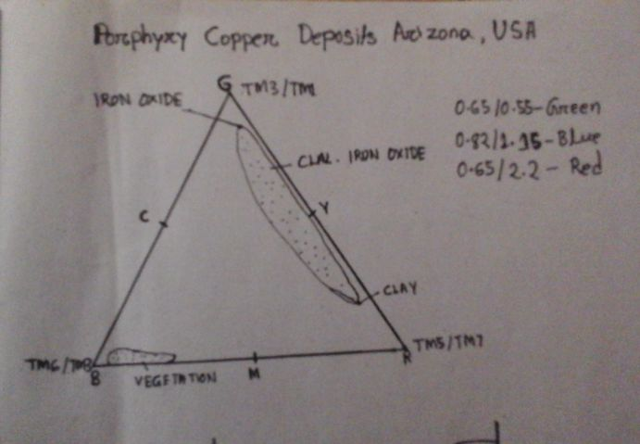
Fig.6. Iron oxide appear green (high 0.65/0.55 band ratio), clay mineral appear red (0.65/2.2 band ratio). The co-occurrence of iron and clay appear in various shades of yellow.

Slide 19
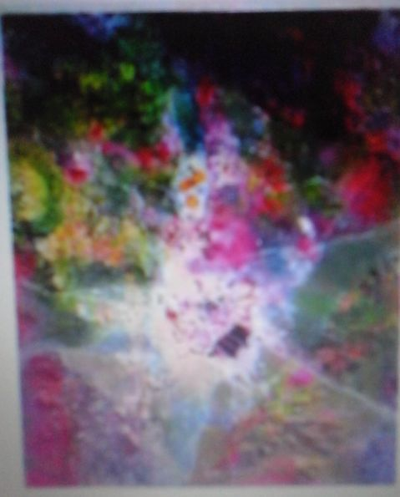
Fig.7.ASTER image showing the open-pit Escondida mine, Chile, ASTER-SWIR bands 4,6,8 are coded in RGB respectively. The Al-OH-bearing minerals appear in shades of blue purple,Mg-OH-bearing minerals appear in shades of green, yellow and Al-Mg-OH-bearing minerals appear in shades of red.( courtesy: NASA/GSFC/MITI/FRSDAC/JASROS, and US/Japan ASTER Science Team)

Slide 20
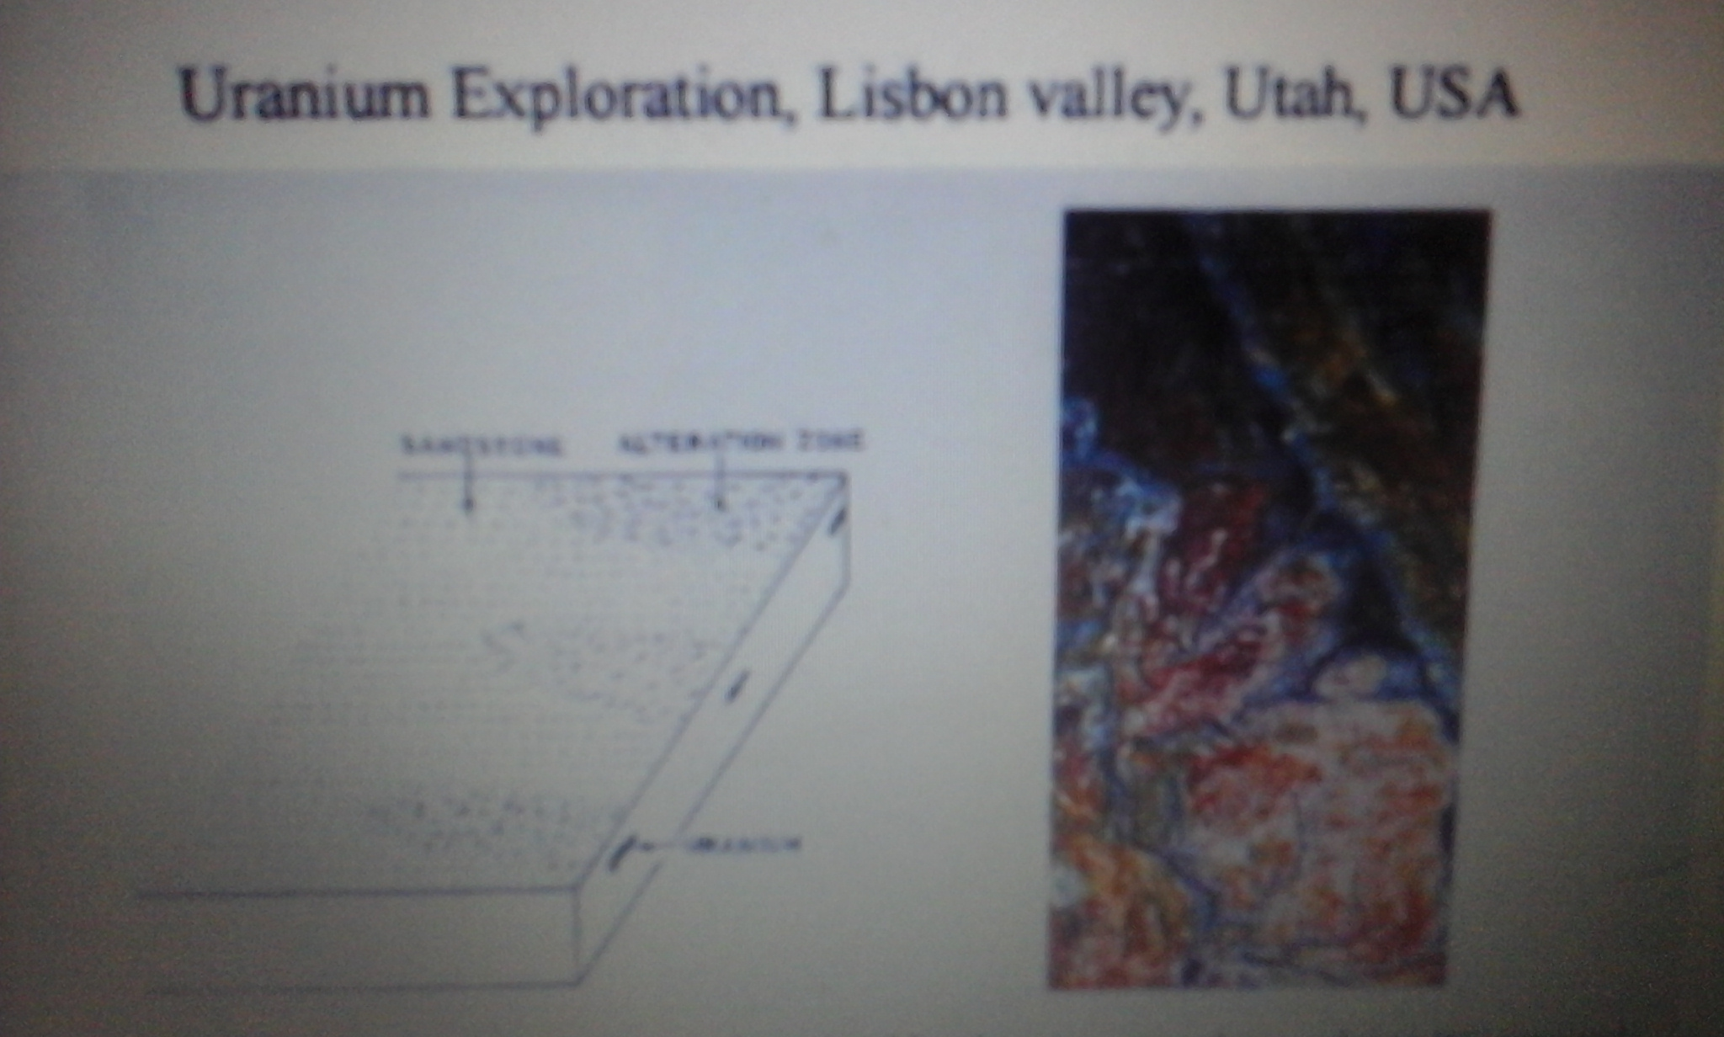
Fig.7. Schematic showing alteration bleaching zone in the overlying Wingatestand-stone associated with the uranium mineralization at depth, b false- color image of the Lisbon valley, generated from canonically transformed aerial scanner data. Red olive greeen color- bleached part of overlying Wingate formation; shades of grey and beige = unbleached Wingate Formation.(b Conel and Alley 1985)

Slide 21
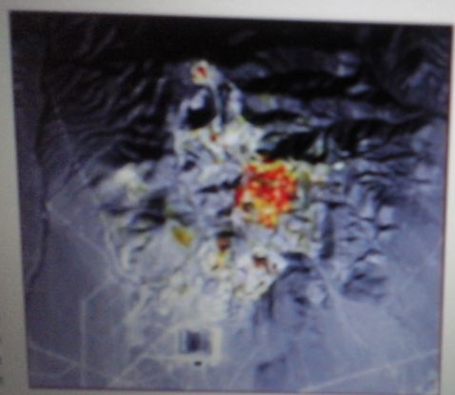
Fusion of 5m resolution IRS I c satellite image 25m LANDSAT TM satellite image.
Image shows iron oxide and clay alteration minerals in red and yellow respectively within existing open pit working on Battle Mountain, Nevada.
The 5m IRS I c satellite provides the detailed topographic & structural information while the LANDSAT TM satellite provides the alteration mineral identification capability.

Slide 22
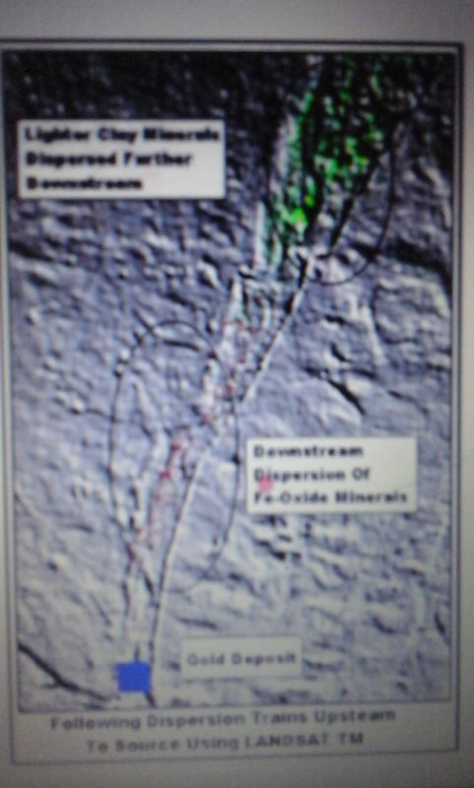
Iron oxide & clay dispersion in stream bed

Slide 23
Geobotany
Geobotany has been defined as the study of plants as related specifically to their geologic environment which includes :
Spatial distribution of plants and plant communities as related to geology.
Vegetation characteristics(physiology, morphology, anatomy, biochemistry) as related to geology.

Slide 24
Geobotany
Vegetation is often influenced by mineralization, lithology, and rock fracturing.
Sites with high concentration of old mine tailings for lead, copper, zinc, nickel and other metals may develop unique floras because condition is toxic for most species.
Naturally occurring saline or alkaline deposits and serpentine outcrops also develop unique floras.
Leaf concentration of trace metals may indicate the composition of underlying soil and thus may be useful for mineral exploration.

Slide 25
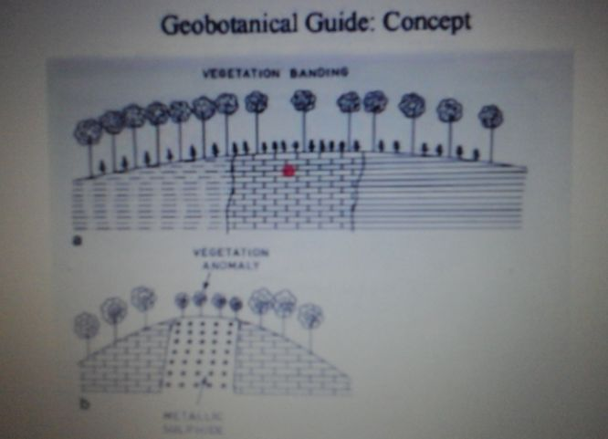
Fig.8. The concept of geobotanical guides, a vegetation bunding- the density of vegetation is related to lethology. B vegetation anomaly as related to the presence of toxic metals, the growth of trees is stuned by toxic metals in soil derived from the bed rock.

Slide 26
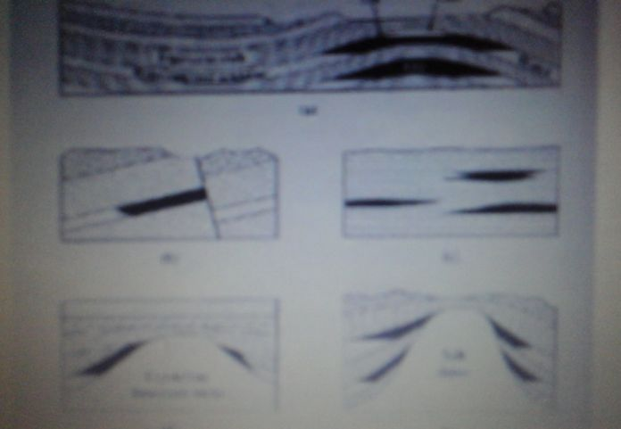
Hydrocarbon Exploration : Traps
Fig.9. Illustration of various types of traps favorable for the accumulation of oil and gas: a) anticline, b) fault, c) stratigraphic, d) crystalline basement rocks and e) salt dome. Notice that traps of (types a , b, and c sometimes also type d) have an influence on the type of rocks exposed at the surface. Strategraphic trap type c do not influence the types of rocks exposed at the surface .

Slide 27
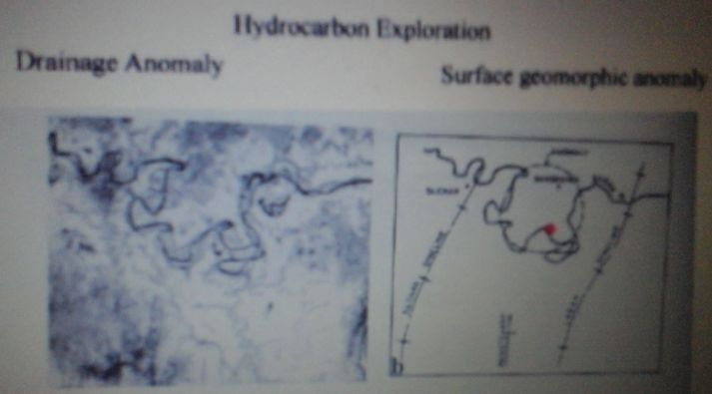
Fig.10. A drainage pattern making the Banskadi anomaly, about 20km in diameter(printed black and white from landsat MMS standard FCC); interpretation showing the anomaly in relation to other field mapped geological features in area. Based on the landsat anomaly, further investigations are carried out; the structure is yielding hydrocarbon gas.

Slide 28
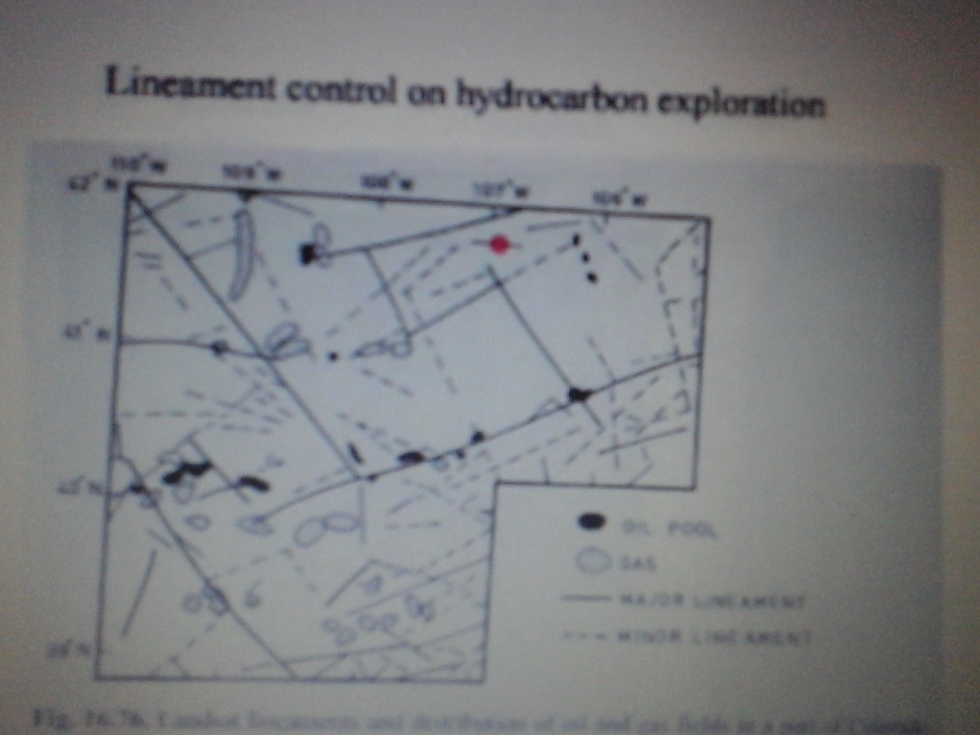
Fig.11. Landsat lineaments and distribution of oil and gas fields in part of Colorado, USA(After Saunders et al, in Hallbouty 1976)

Slide 29
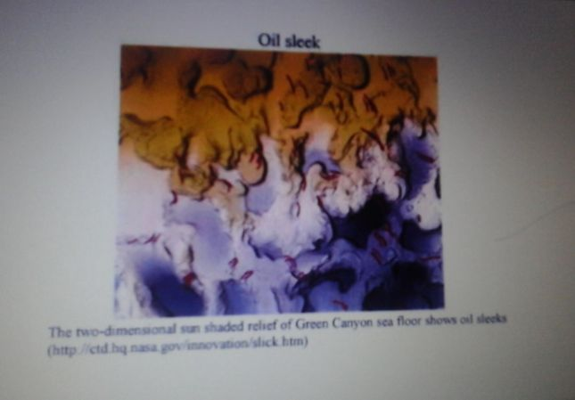

Slide 30
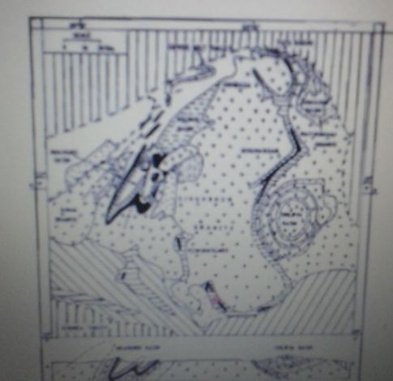

Slide 31
Satellite data products used
Optical
IRS-LISS-II FCC(432) on 1:125,000
IRS-LISS-II FCC(432) on 1:50,000 and digital data
LANDSAT-5 TM FCC(754) 1:50,000 and digital data
Microwave
ERS-1-SAR descending node image on 1:125,000
ERS-1-SAR descending node digital data for 3 different dates(15.04.92, 11.11.92 and 16.12.92)
Ers-1-SAR ascending node digital data

Slide 32
Digital image processing results
Digital image processing and band combination | Highlighted features
ERS-1 SAR 15.04 .92 R Temporal FCC 16.12.92 G 11.11.92 B | Highlights structure and major litho-units
ERS-1 SAR KL Transformation of temporal data | Reduce speckles highlights topographic detail in KL-1 image
HIS Transformation of TM234 and Intensity is replaced by SAR-KL | Structure, mining and topographic details with surface cover
ERS-1-SAR FCC with 2 date data and compliment of SAR-KL | Structural details are more clear and mapable
TM FCC 754 | Differentiate lava from shale and highlights mining status in the region . Good for lithological interpretation
TM 6/5 and SAR-KLI | Surface cover and mining with topographical details
TM 3/4 5/2 3/2 | Highlights Fe and Mn mines and lateritic cover

Slide 33
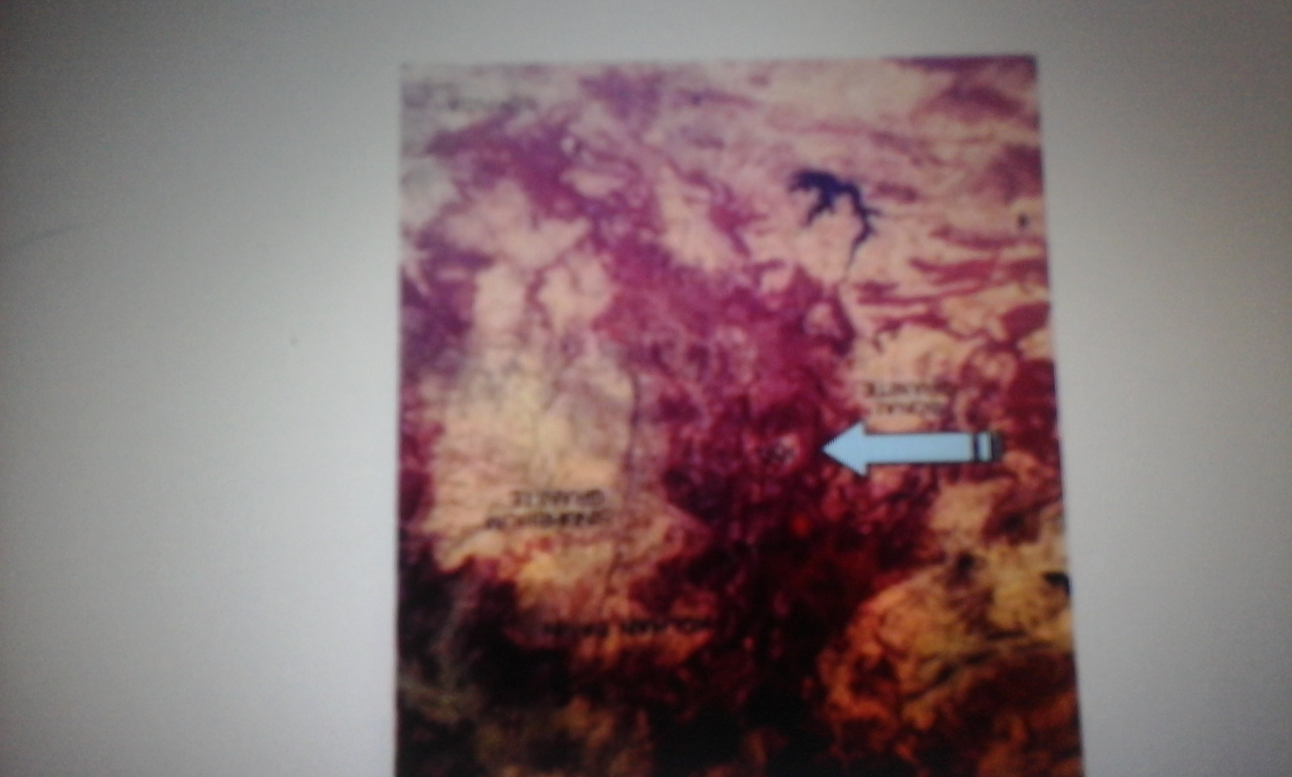

Slide 34
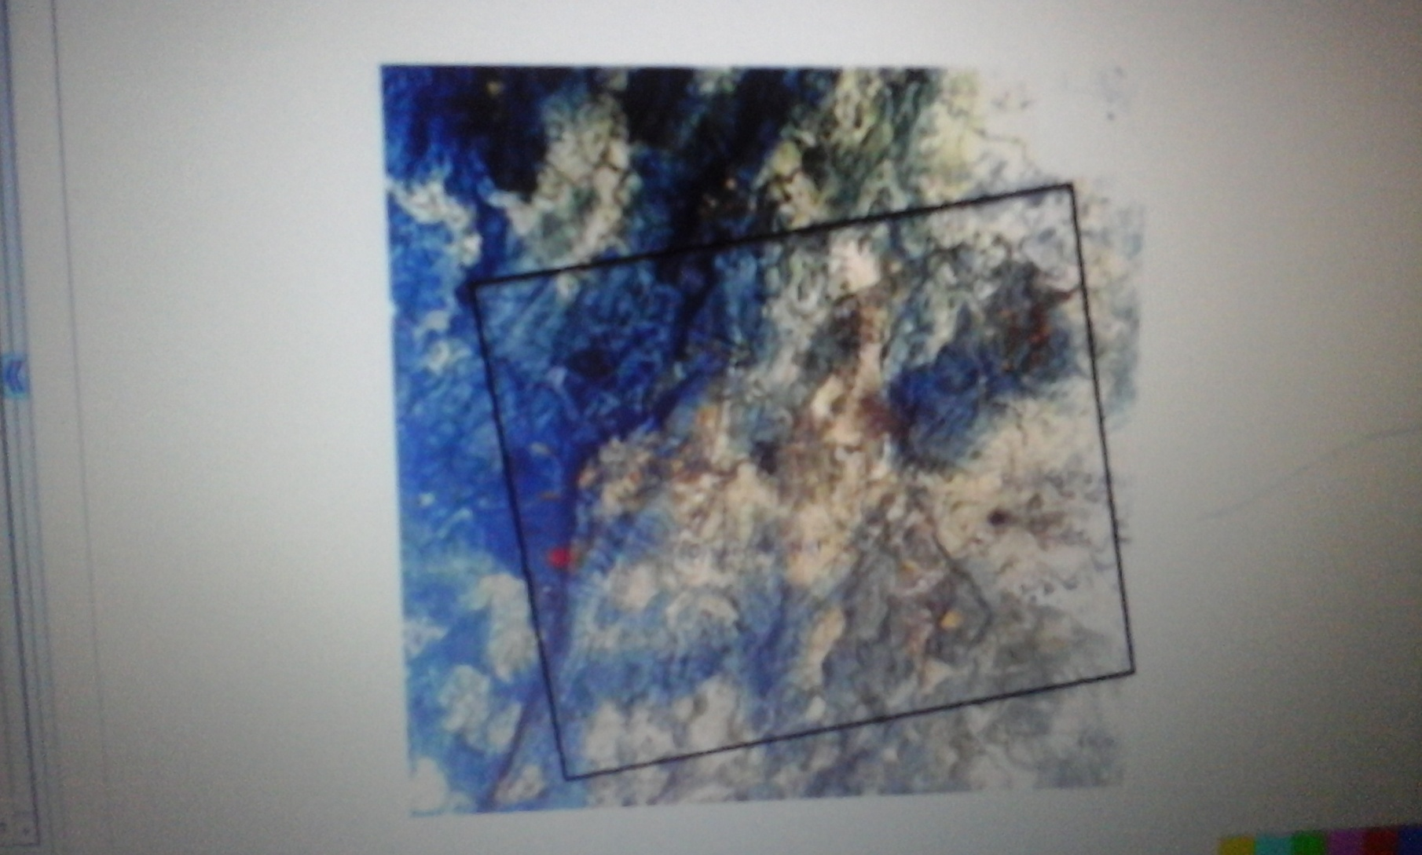

Slide 35
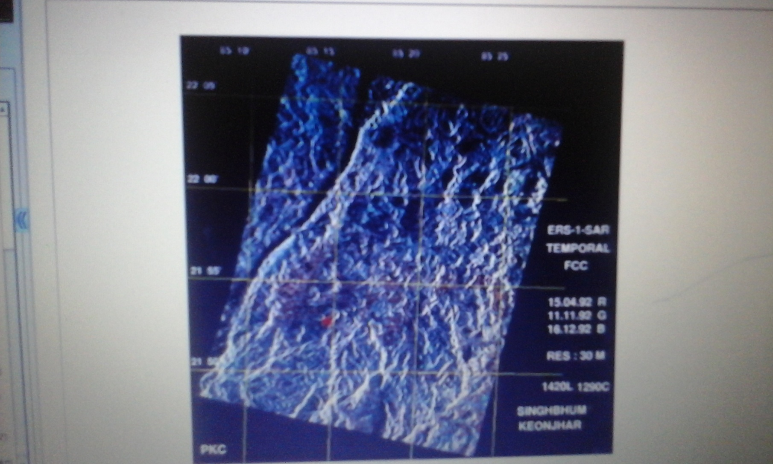

Slide 36
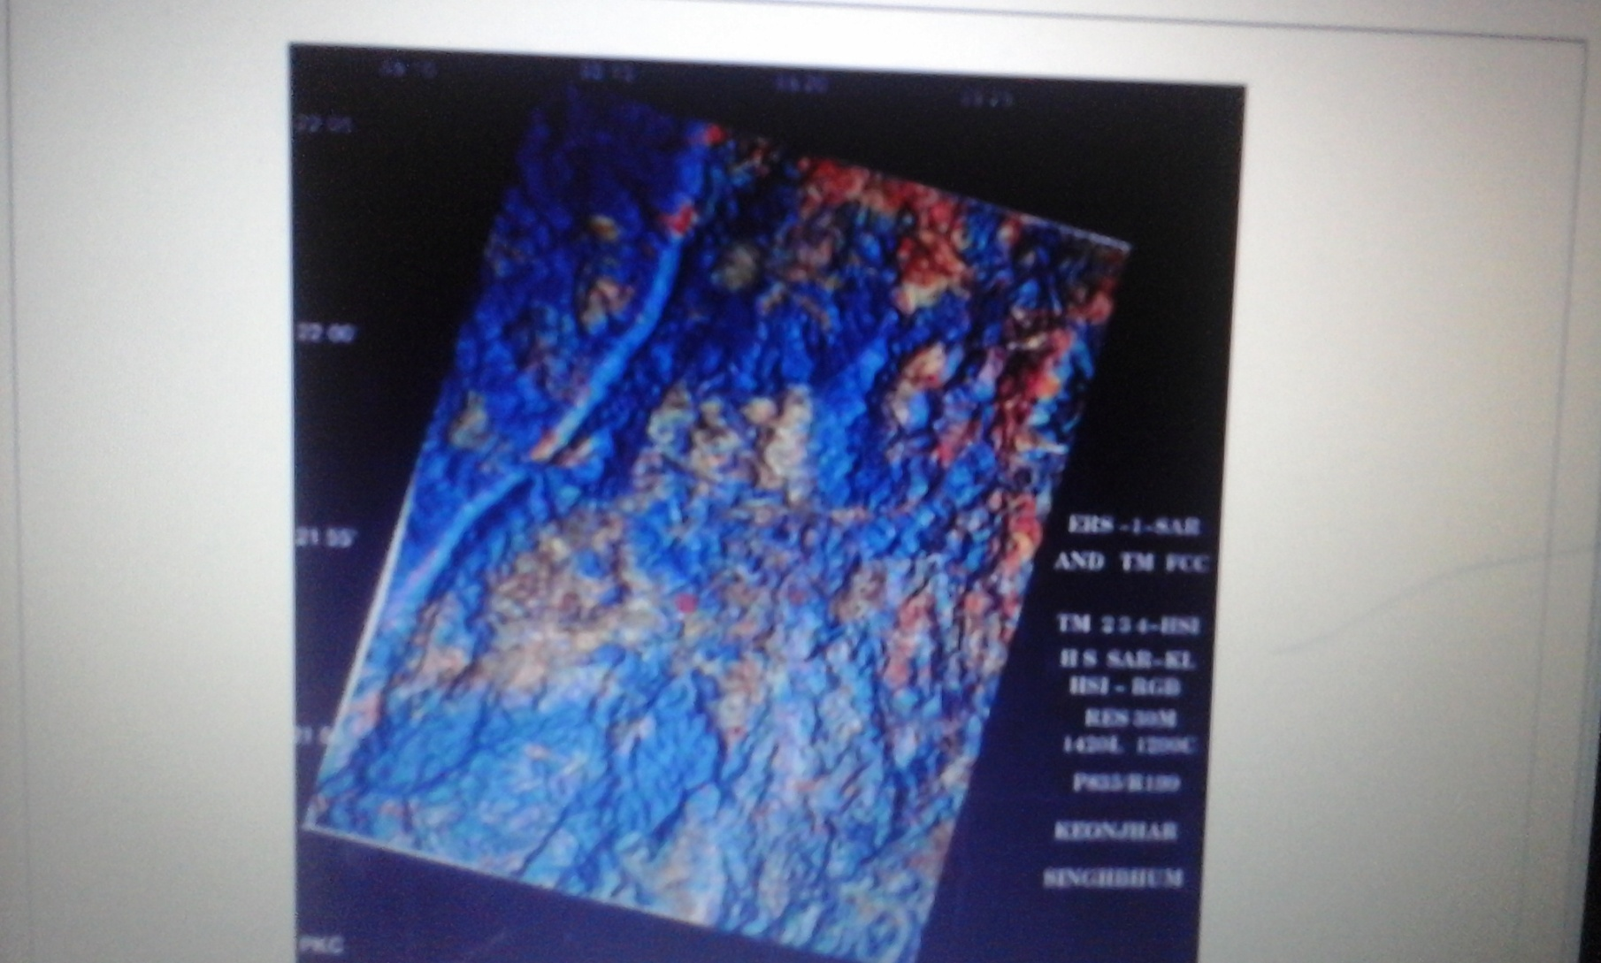

Slide 37
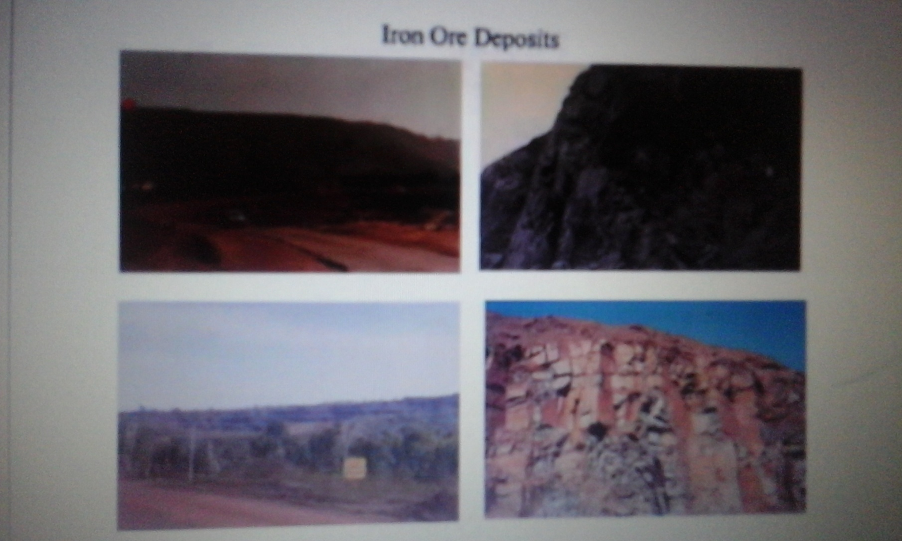

Slide 38
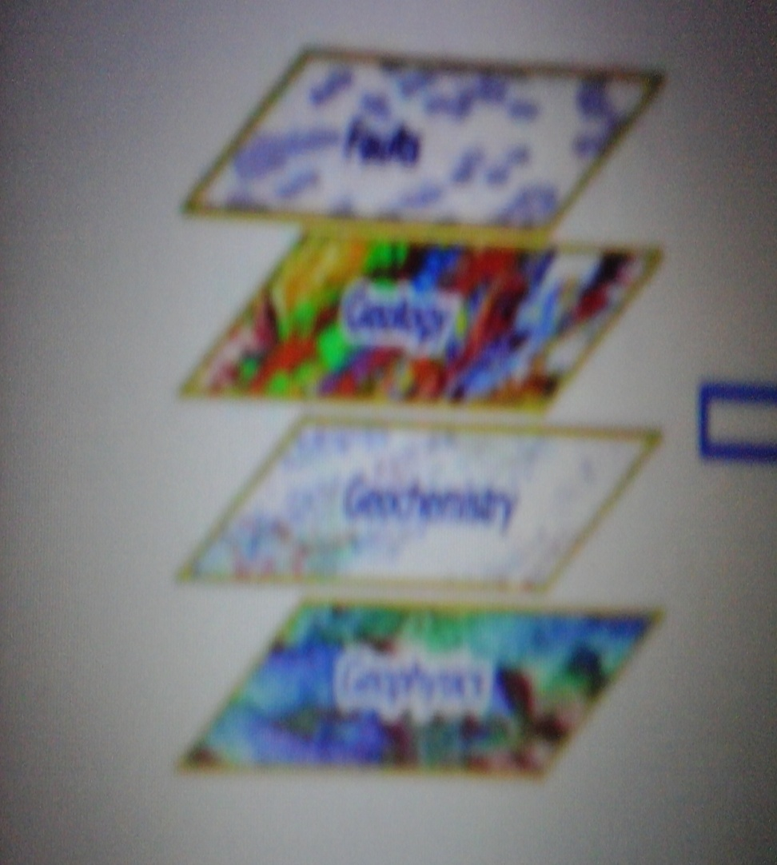
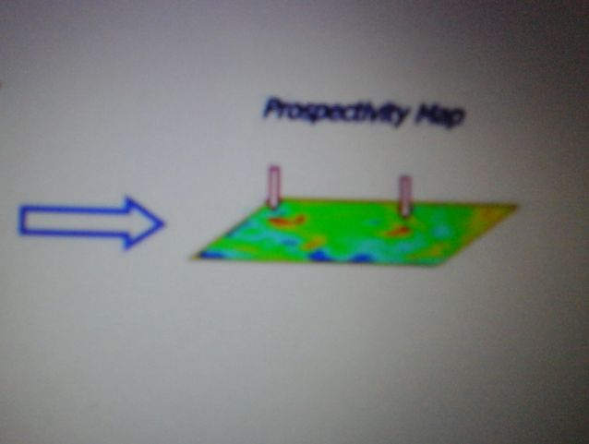
GIS: Data integration for mineral exploration

Slide 39
INTRODUCTION
GIS is a set of computer based systems for managing geographic data and using these data to solve spatial problems. And it is helpful in integrating geological database for mineral exploration.
The process of mineral exploration composed of several stages which starts with small scale and develops into large scale.
In every stage, Geological, Topographical, Geophysical, Geochemical data are collected , processed and integrated. Then after finishing every stage produced mineral potential map and the study area becomes smaller.

Slide 40
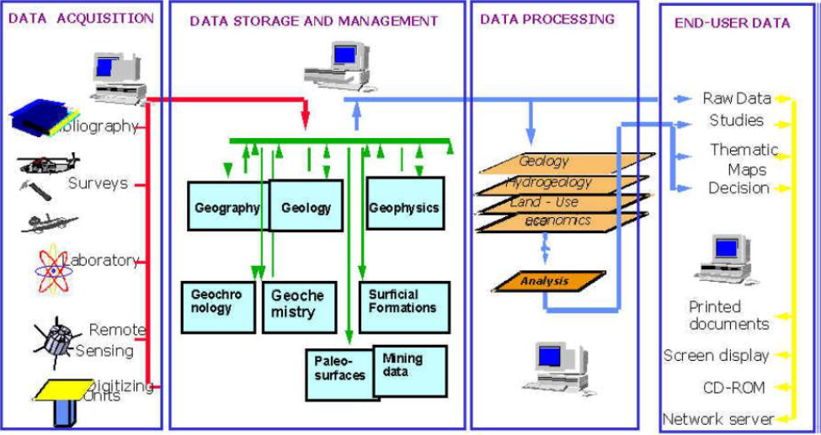
GIS can easily integrate with other specific programs for image and geographical data processing, so, Raster images such as satellite imagery or geophysical images can be displayed in GIS and overlaid with vector data such as geology, fault and geochemical sample.

Slide 41
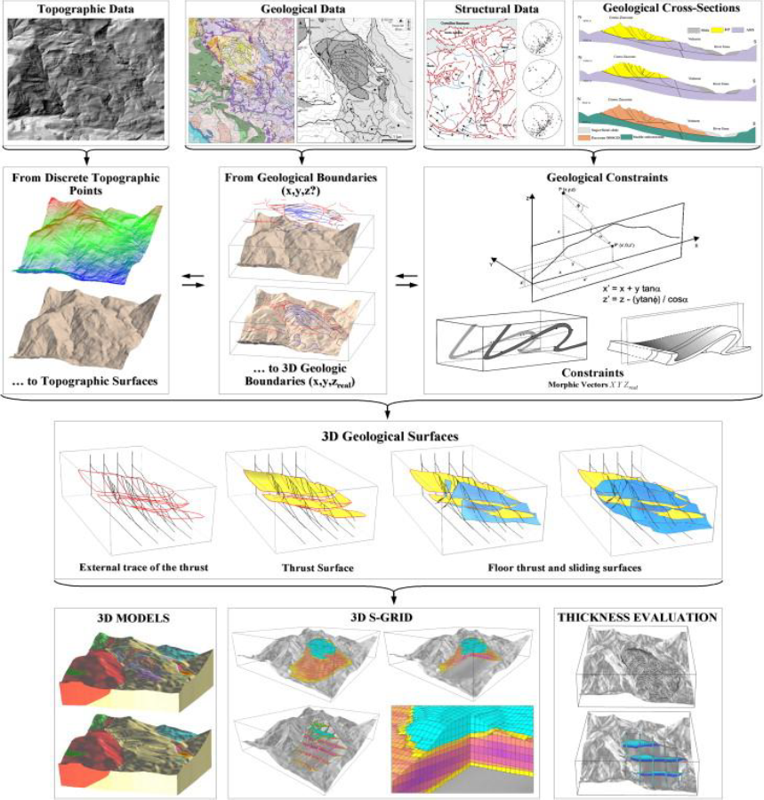

Slide 42
.
Methodologies:
Due to the nature of the process of mineral exploration, geologists deal with a variety of data from different sources to explore for mineral deposits. They need to display and interpret this information quickly and easily. So, the study divided into several stages:
- Design the geodatabase according to the information that will go to be needed.
- Collect different datasets from a variety of sources and select the datasets which related to the study.
- Define the geological features based on the geological background and concepts that indicate to an area of mineralization.
- Bring all the datasets within the geodatabase along with all available and previous maps, charts and studies.
- Defining regions of interest from maps and graphs and it'll be created using a shape file from ArcGIS.

Slide 43
…
Benefits of GIS in mineral exploration:
1- It combines data and datasets from different sources with ease.
2- It is linked directly from modeling software such as; MapInfo and Leapfrog to database of results, ensuring the most recent assay information from analytical testing.
3- Model quickly and easily in 3D. the resource we are exploring from both historical and modern drillhole data stored in our database.
4 - This method of modeling saves digitizing many different features to be included in the model as it can be interpolated from the drillhole data by the system.
5 -GIS can save money and decrease the regular cost to explore for minerals.

Slide 44
6- Fewer hours spent digitizing to incorporate data into models.
7- Variety of GIS analysis methods on quantitative and raster data to look for anomalous areas.
8- The ability to capture old data of different types and view/analyze as compatible layers. Some of this data would only previously have been examined in paper formats.
9- Ability to utilize free historical and modern data in current projects - there is a wealth of mineral exploration resources available on the web for free which can be utilized in the search for ore bodies: historical geological maps, satellite imagery, geophysical data and geochemical assay results data for the exploration target area in question are published freely on the internet.
10 - Using GIS in mineral exploration encourages a more efficient use of already existing data which is cost effective. Exploration costs are rising –exploration drilling can be expensive and the rate of discovery of large world-class ore bodies is decreasing. However, re-analysis of existing data – both modern and historical, through GIS modeling e.g. through 3D modeling, allows for more targeted, cost effective exploration drilling.

